Slide 1
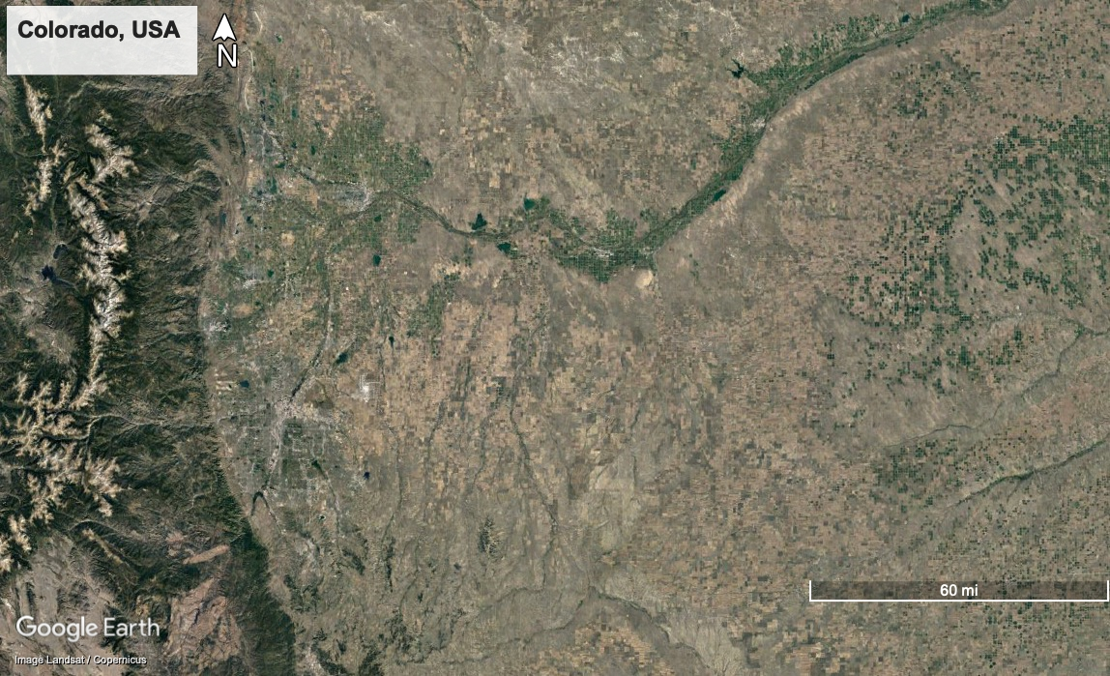
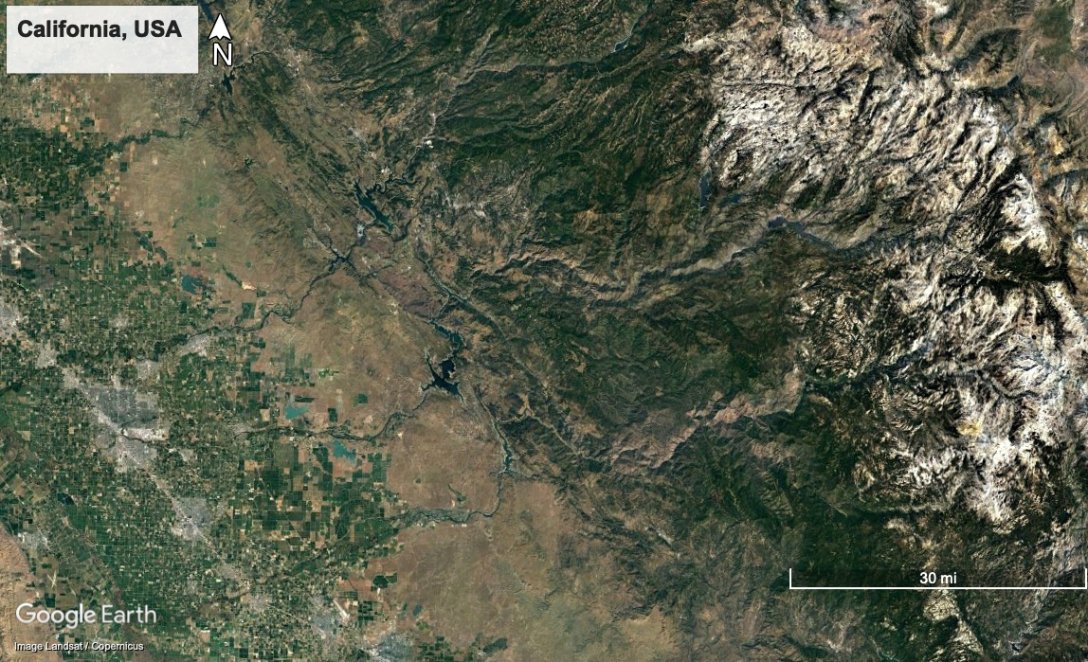
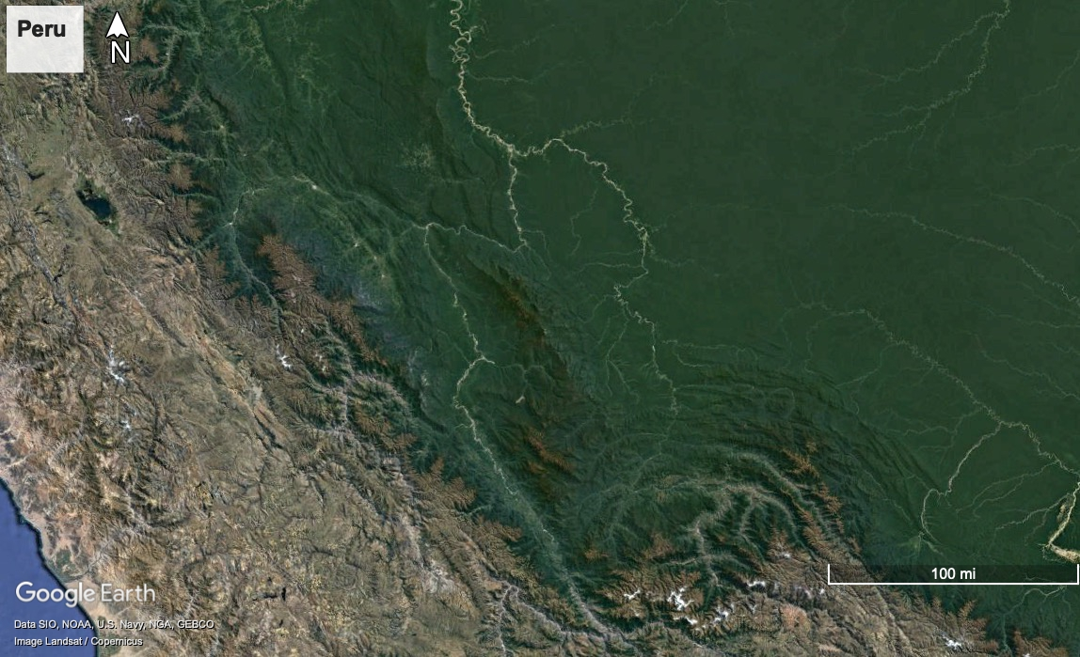
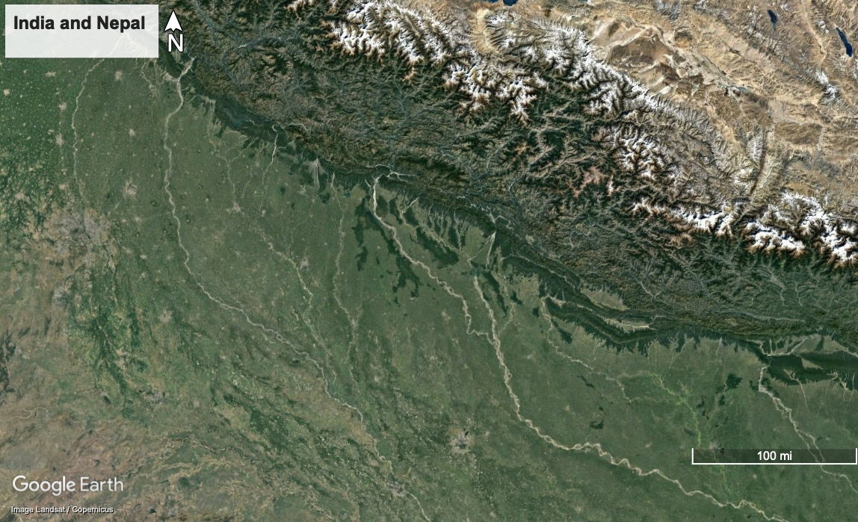
Zone 14S Easting: 244591, Northing: 4322768
Zone 11S Easting: 303534, Northing: 4130456
Zone 19L Easting: 334114, Northing: 8495989
Zone 45R Easting: 264843, Northing: 2881493

Slide 2
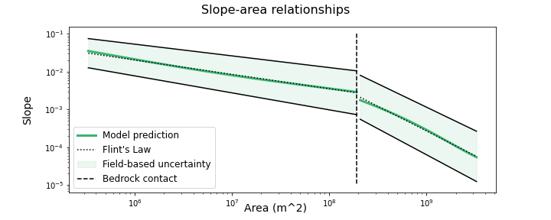
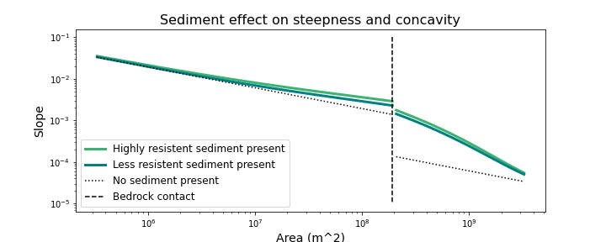
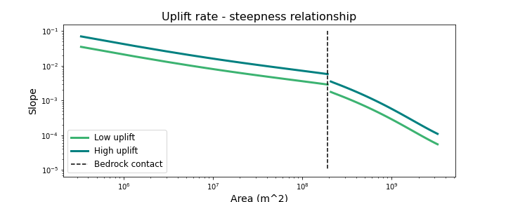
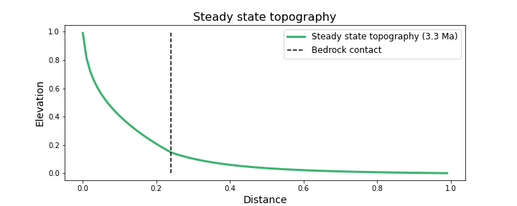
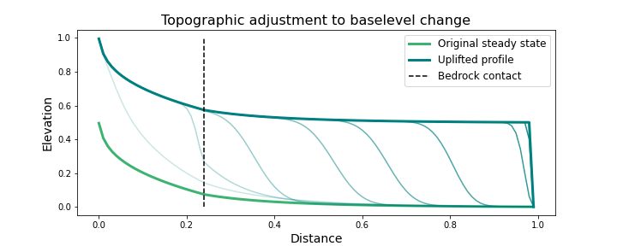

Slide 3








flow
Sediment and bedrock have different properties!
Rate of grain attrition depends on properties of the source rock
Abrasion rate depends on properties of the bedrock

Slide 4


Slide 5








H
Q, Q_{s}
$$η_{b}$$
q_{L}
x
b
B
U

Slide 6
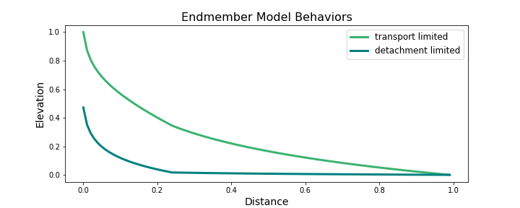

Slide 7
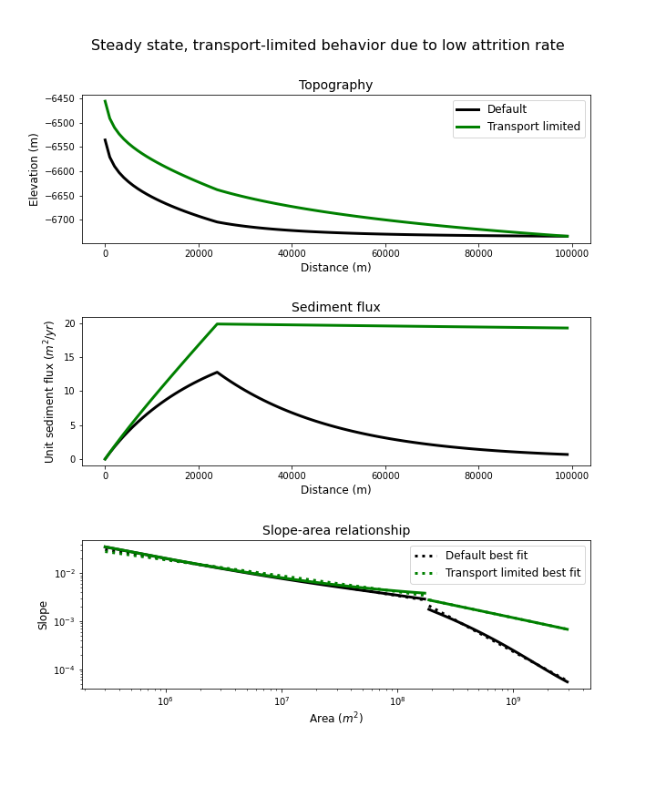
Currently this fig shows how TPL behavior can be forced by setting attrition rate low; also want to modify to show show DTL behavior can be forced by setting attrition rate high; this may include adding the stream power model to lower panel for comparison (and also topo?)

Slide 8
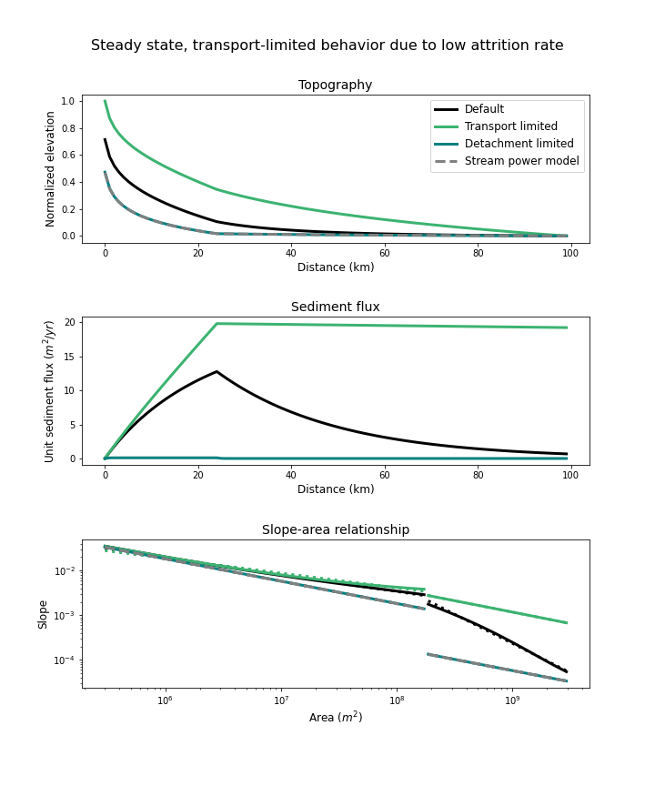

Slide 9
